Slide 1
Intro to Memory Forensics and Tactics
ISSA/InfraGard Feb 2014
Joe Partlow - CISO, ReliaQuest
Michael Rogers – Security Engineer, ReliaQuest

Slide 2
Why Memory?
Memory forensics is the practice of extracting and analyzing artifacts left in the system’s memory during or after use
Many new pieces of malware are memory resident only to avoid traditional disk based discovery.
Most if not all malware now has memory–resident components
MS EMET (Enhanced Mitigation Experience Toolkit) aware malware – stops execution (and potential detection) if EMET is running on the machine.

Slide 3
The Process
Dumping the memory
…Lots of hours of scripts and stuff…
Profit!

Slide 4
Dumping memory
Don’t restart the machine or the classic “pull the plug”.
Hardware – Does not write into memory and potentially trash artifacts, but needs to be installed ahead of time. Can be separate PCI cards installed ahead of time or the “freezing method”.
Software – Easiest method, but requires the software program to be loaded into memory and may alter existing artifacts. Sometimes requires agents to be loaded.
Crash Dumps – Most accurate but may truncate memory in the dump.

Slide 5
Dumping memory (cont.)
Tools:
Volatility
FTK
MoonSols MemDump
Windump
EnCase
Mandiant Memoryze
LIME (Linux Memory Extractor) - for Linux and Android

Slide 6
Dumping memory (cont.)
There are many interesting areas to grab the memory from including:
Page/Swap files
Hibernation Files
VM snapshots
Old crash dumps

Slide 7
Analyzing memory
Parsing the memory
Extract any images
Find associated data and processes/network connections
Timeline and document infection
Recommend doing this on linux versus windows since grep, strings and other utilities come in handy! (or use cygwin)
So what can we see…

Slide 8
Analyzing memory – detailed
Identify Rogue Processes
Analyze Process DLLs and Handles
Review Network Artifacts
Look for Evidence of Code Injection
Check for Signs of a Rootkit
Dump Suspicious Processes and Drivers

Slide 9
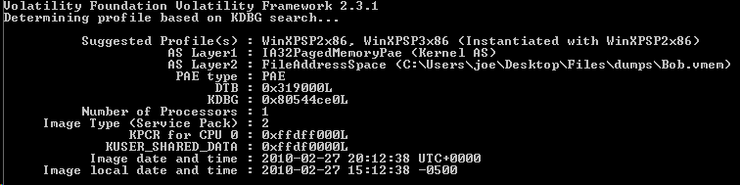
System Information
What type of machine was the memory taken from
volatility-2.3.1.standalone.exe –f victim.vmem imageinfo

Slide 10
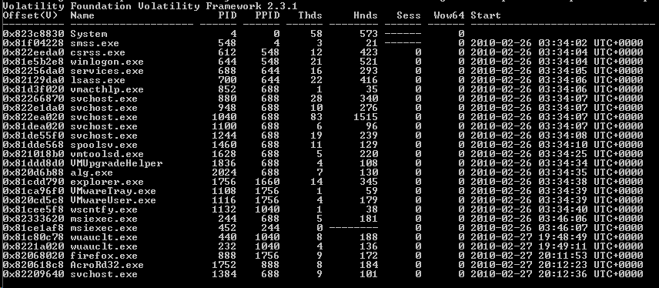
Process List
Processes running on victim’s machine
volatility-2.3.1.standalone.exe –f victim.vmem pslist

Slide 11
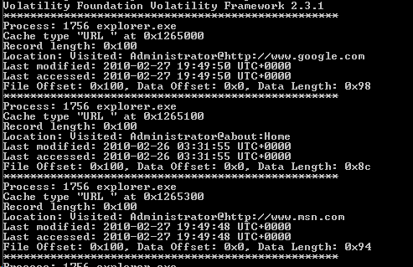
IE History
Get list of browser history from IE
volatility-2.3.1.standalone.exe –f victim.vmem iehistory

Slide 12


Browser History (Encase)
Encase also has ability to pull complete browsing history
With image carving:
201) Memory test 1\test\Physical Memory GIF: Physical Memory File offset: 1180075440 Length: 43 MD5 Hash: 325472601571F31E1BF00674C368D335
204) Memory test 1\test\Physical Memory GIF: Physical Memory File offset: 1184646749 Length: 81 MD5 Hash: C38506399BEFFC2DA37BF3EBAF1BA799

Slide 13
Browser History (Encase)
Encase also has ability to pull complete browsing history
Without image carving:

Slide 14
Name | Preview | Web Site
Physical Memory | l/products/microsoftrootcert.crl0T + H0F0D + 0 †8http://www.microsoft.com/pki/certs/MicrosoftRootCert.crt0€ U y | http://www.microsoft.com/
Physical Memory | ¬ ¯ Ä E http://www.e5hforensics.com/memoryanalysis.com/acquisition_tools.h | http://www.e5hforensics.com/memoryanalysis.com/
Physical Memory | Õ Ô© g G Éÿÿÿ ¬. Ô© g Œ¥ à ² H¨ ghttp://www.guidancesoftware.com/_layouts/scripts/jquery.imgcenter/ | http://www.guidancesoftware.com/
Physical Memory | i l . l i v e . c o m / m a i l / c l e a r . g i f s _fhttp://mail.aol.com/38289-111/aol-6/en-us/mail/DisplayMessage.aspx | http://mail.aol.com/
Physical Memory | tent-Length: 14683 X-CDN: LLNW access-control-allow-origin: http://www.linkedin.com & æ P H P S E S I D = e | http://www.linkedin.com
Physical Memory | oducts/MicrosoftTimeStampPCA.crl0X + L0J0H + 0 †<http://www.microsoft.com/pki/certs/MicrosoftTimeStampPCA.crt0 U | http://www.microsoft.com/
Physical Memory | € <a href="http://www.quantcast.com/p-b3sGjMtCFrexE" target="_blank"><img src | http://www.quantcast.com/
Physical Memory | uB„Ð¦ ]R¶Þ–"Ê3)ã{…ô s¾Dú&}„ C ýc úÇ H #'y"ÊÞ¼úúNNkBçU¹¹éhttps://my.screenname.aol.com/_cqr/login/login.psp?sitedomain=sns. | https://my.screenname.aol.com
Physical Memory | sh xmlns:asmv2="urn:schemas-microsoft-com:asm.v2" xmlns:dsig="http://www.w3.org/2000/09/xmldsig#"><dsig:Transforms><dsig:Transfo | http://www.w3.org/
Physical Memory | s/webmail/11.0.2-RC/sprites/email.png H¨_f K https://apps.rackspace.com/versions/webmail/11.0.2-RC/sprites/emai | https://apps.rackspace.com/versions/webmail/

Slide 15
Complete Address book? (Encase)
Discovered a fun fact:
When dumping the memory on a test account we saw that the entire address book from the webmail account had been downloaded and subsequently kept in memory…
As a side note, this can also be accomplished with Volatility using combination of strings, grep, sed, awk and other linux-fu

Slide 16
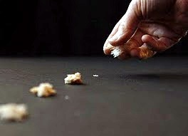
Good Starting Point
Suspect used web based mail.
Have multiple e-mail contacts that know the suspect.
Websites visited.
Following the bread crumbs…

Slide 17
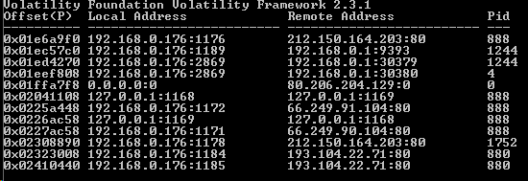
Network Connections
List of network connections
volatility-2.3.1.standalone.exe –f victim.vmem connscan

Slide 18
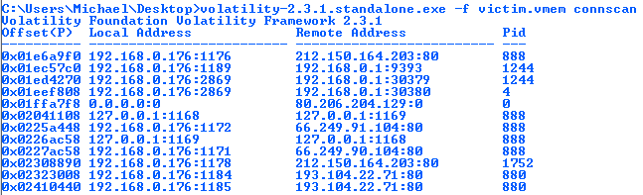
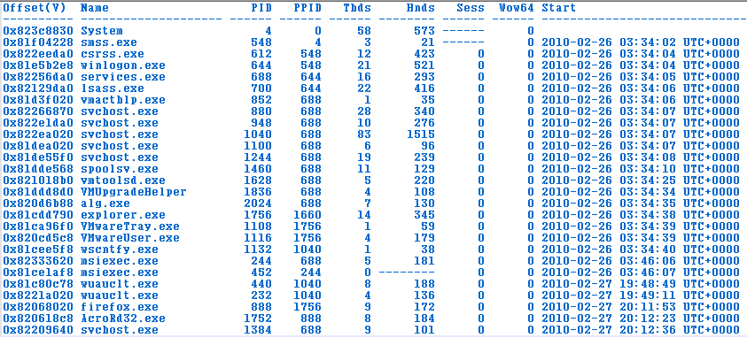
Connections/Processes

Slide 19
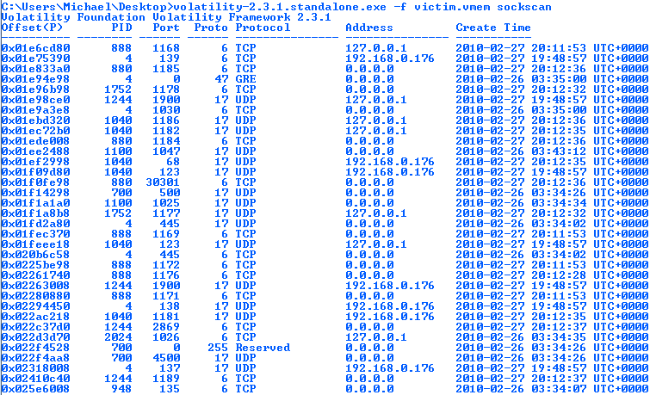
Sockets Scan

Slide 20
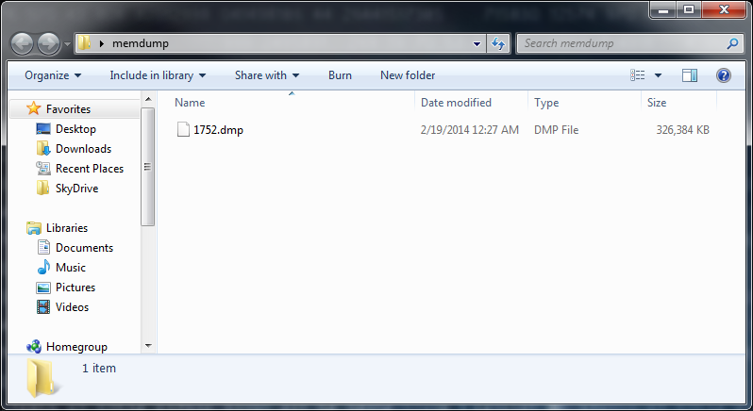
Dump out Adobe Reader File

Slide 21
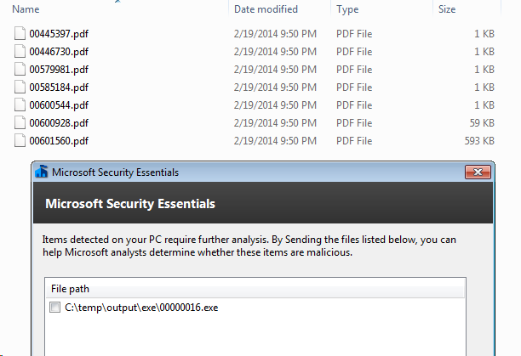
Parse Files
Once we have the dump for that process, we can start parsing for actual files
foremost -i 1752.dmp –o “C:\temp\output”

Slide 22
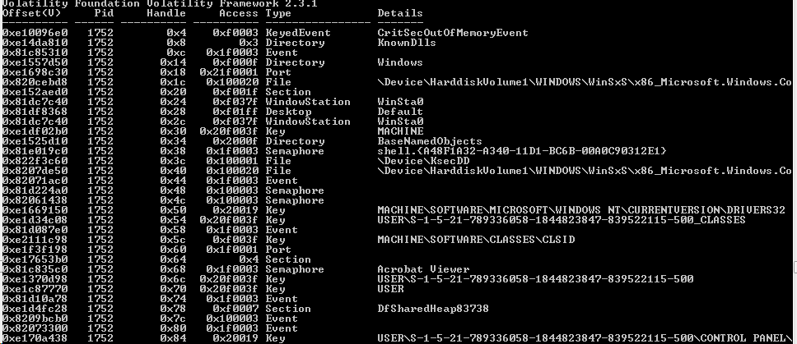
Handle Checks
Display any handles being used by the process ID
volatility-2.3.1.standalone.exe –f victim.vmem handles –p 1752

Slide 23
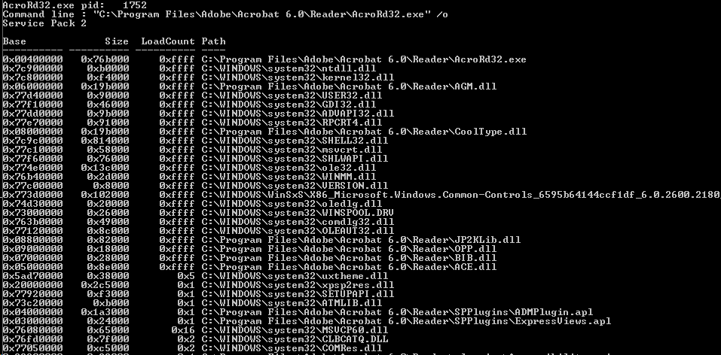
DLL Checks
Display any dlls being used by the process ID
volatility-2.3.1.standalone.exe –f victim.vmem dlllist

Slide 24
Clipboard Contents
Find artifacts that may still be in the clipboard memory
volatility-2.3.1.standalone.exe –f victim.vmem clipboard

Slide 25
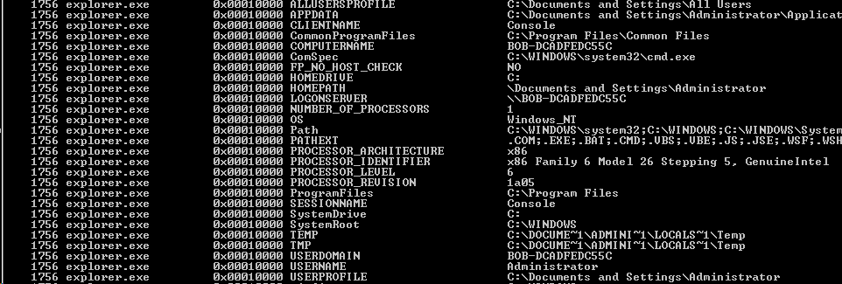
Environmental Variables
Many items that may be helpful in attribution including hostname, logonserver, path, sessionname, username, etc.
volatility-2.3.1.standalone.exe –f victim.vmem envars

Slide 26
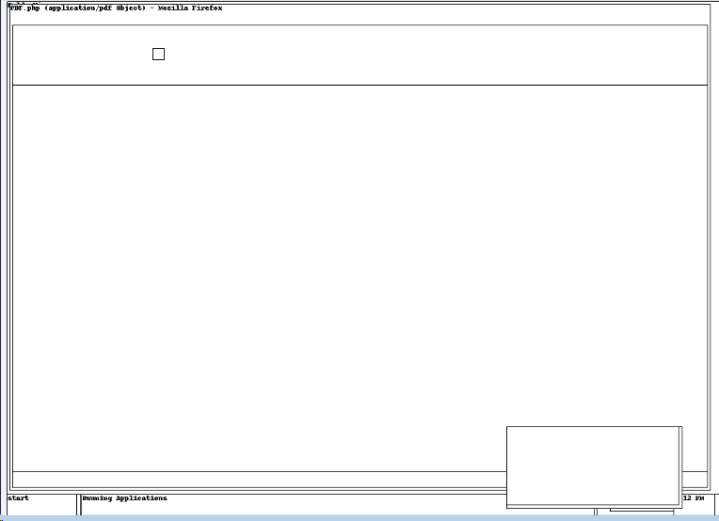
Screen Layout
Attempts to grab a visual wireframe representation of the user’s active desktop
volatility-2.3.1.standalone.exe –f victim.vmem screenshot –-dump-dir=“c:\temp”

Slide 27
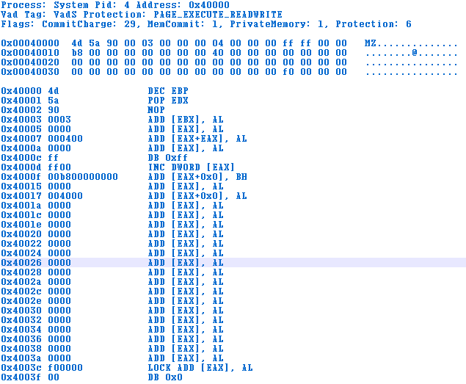
Malware Finder
Extract any executables from processes and check for known signatures
volatility-2.3.1.standalone.exe –f victim.vmem malfind –output-file=malware1

Slide 28
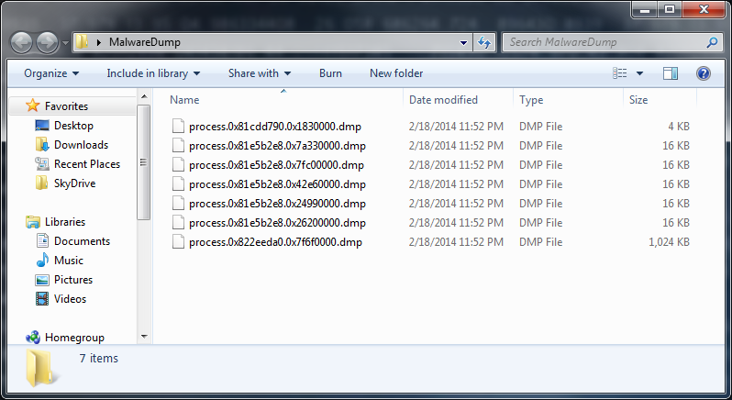
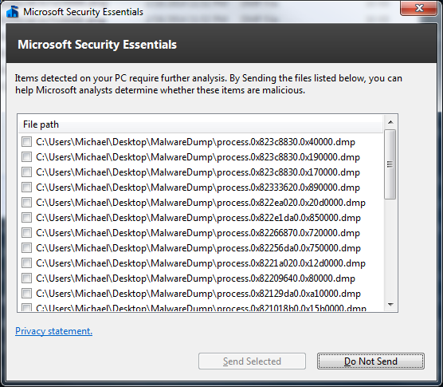
Don’t Dump it on your computer…

Slide 29
Other Fun Options
These commands could also yield some good data:
Cmdscan – list of all commands used based off history
Dumpcerts – Finds all RSA public and private SSL keys
Hashdump – Dumps any SAM hashes to be used to potential cracking
Windows – Shows all window handles and associated processes running at the time of the memory capture
Registry options including hivelist, hivescan, printkey which will show you active keys being used by the running processes

Slide 30
Demo
Quick survey on who uses Truecrypt…
Demo of memory dump is too slow…

Slide 31
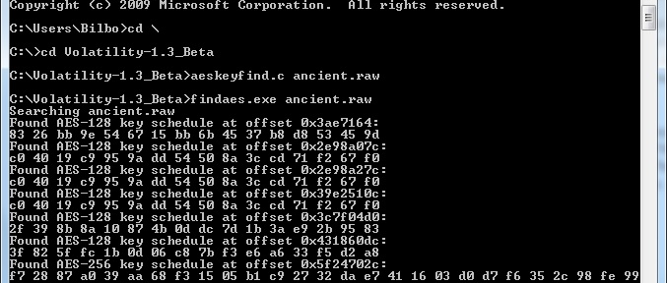
keyfindaes
(creator: Jesse Kornblum)
Scans for AES128, AES192, and AES256 keys. (Isn’t limited to just memory samples)
Provides keys to your encrypted volumes – Able to Mount volumes with the keys snagged!

Slide 32
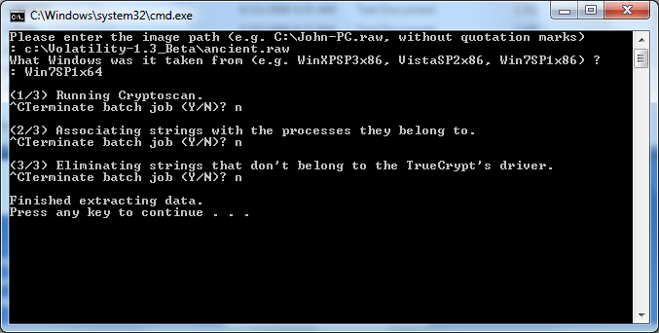
Running CryptoScan

Slide 33
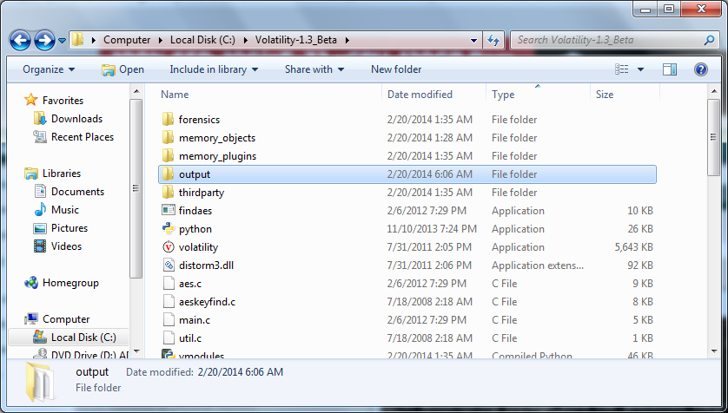
CryptoScan Output

Slide 34
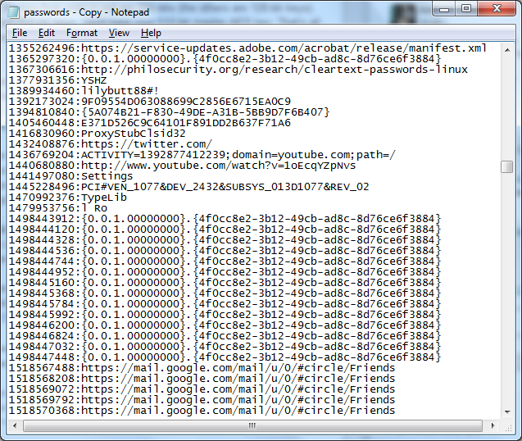
CryptoScan Results
<-My wireless password..

Slide 35
TrueCryptMaster
Tool operates the same as TrueCrypt
$ python vol.py -f WIN-QBTA4.raw --profile=Win2012SP0x64 truecryptmaster -D .
Volatility Foundation Volatility Framework 2.3.1 (T)
Container: \Device\Harddisk1\Partition1
Hidden Volume: No
Read Only: No
Disk Length: 7743733760 (bytes)
Host Length: 7743995904 (bytes)
Encryption Algorithm: SERPENT
Mode: XTS
Master Key
0xfffffa8018eb71a8 bbe1dc7a8e87e9f1f7eef37e6bb30a25 ...z.......~k..%
0xfffffa8018eb71b8 90b8948fefee425e5105054e3258b1a7 ......B^Q..N2X..
0xfffffa8018eb71c8 a76c5e96d67892335008a8c60d09fb69 .l^..x.3P......i
0xfffffa8018eb71d8 efb0b5fc759d44ec8c057fbc94ec3cc9 ....u.D.......<.
Dumped 64 bytes to ./0xfffffa8018eb71a8_master.key
Notes:
You now have a 512-byte Serpent master key, which you can use to decrypt the roughly 8 GB USB drive. It tells you the encryption mode that the suspect used, the full path to the file or container, and some additional properties such as whether the volume is read-only or hidden. As you may suspect, the plugin works regardless of the encryption algorithm, mode, key length, and various other factors which may complicate the procedure of finding keys. This is because it doesn't rely on the key or key schedule patterns -- it finds them in the exact same way the TrueCrypt driver itself finds the keys in RAM before it needs to encrypt or decrypt a block of data.

Slide 36
TrueCryptSummary
$ python vol.py -f WIN-QBTA4959AO9.raw --profile=Win2012SP0x64 truecryptsummary
Volatility Foundation Volatility Framework 2.3.1 (T)
Process TrueCrypt.exe at 0xfffffa801af43980 pid 2096
Kernel Module truecrypt.sys at 0xfffff88009200000 - 0xfffff88009241000
Symbolic Link Volume{52b24c47-eb79-11e2-93eb-000c29e29398} -> \Device\TrueCryptVolumeZ mounted2013-10-11 03:51:08 UTC+0000 <- Mount Date
Symbolic Link Volume{52b24c50-eb79-11e2-93eb-000c29e29398} -> \Device\TrueCryptVolumeR mounted2013-10-11 03:55:13 UTC+0000
File Object \Device\TrueCryptVolumeR\$Directory at 0x7c2f7070
File Object \Device\TrueCryptVolumeR\$LogFile at 0x7c39d750
File Object \Device\TrueCryptVolumeR\$MftMirr at 0x7c67cd40
File Object \Device\TrueCryptVolumeR\$Mft at 0x7cf05230
File Object \Device\TrueCryptVolumeR\$Directory at 0x7cf50330
File Object \Device\TrueCryptVolumeR\$BitMap at 0x7cfa7a00
File Object \Device\TrueCryptVolumeR\Chats\Logs\bertha.xml at 0x7cdf4a00
Driver \Driver\truecrypt at 0x7c9c0530 range 0xfffff88009200000 - 0xfffff88009241000
Device TrueCryptVolumeR at 0xfffffa801b4be080 type FILE_DEVICE_DISK
Container Path: \Device\Harddisk1\Partition1 <- Container (USB Drive)
Device TrueCrypt at 0xfffffa801ae3f500 type FILE_DEVICE_UNKNOWN

Slide 37
Anti-Forensics
Like other areas of forensics (network, disk, etc.), there is an interest to hide activities with various methods
Stop the acquisition process from happening
Pollute or hide the results
Cause “reasonable doubt”

Slide 38
Anti-Forensics - cont
Lots of cool area of research and like everything in security, it’s a cat and mouse game
ADD (Attention Deficit Disorder) – Presented at Shmoocon this year, at a high level scatters artifacts around, alters signatures and adds fake evidence (network connections, well known rootkit drivers, fake processes). EVIL!
This also leaves behind traces and can be picked up sometimes by being thorough in looking in all areas for malicious traffic.

Slide 39
Challenges
More people paying attention to anti-forensics. Lots of cool techniques for anti-acquisition to just wasting the investigators time (and $$$)
SSD – high level - data is sometimes wiped after use instead of overwritten like a traditional disk. Data is stored much more random even though still uses the same logical to physical block translation table and appears like a traditional disk
Very volatile and more devices taking advantage of RAM. How to get a good picture without imaging constantly? Also remote wipe capabilities etc for most mobile devices.
Mobile devices – ADB is sloooowww for pulling image, dump to SD card if possible.

Slide 40
Questions?
Thank You!
Joe Partlow (jpartlow@reliaquest.com)
Michael Rogers (mrogers@reliaquest.com)

